Slide 1
SVN turorial Aqueduct working day
Dirk Eilander

Slide 2
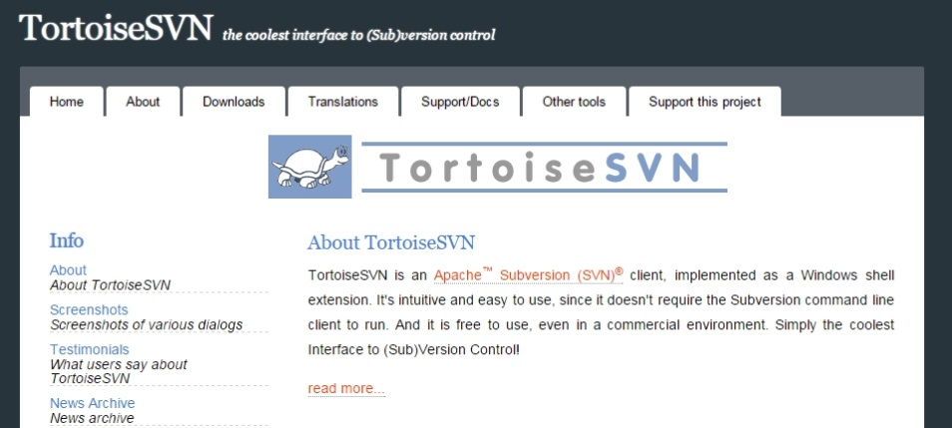
SVN tutorial
What is SubVersion?
A free and open source system for version control of source code and other documents
Benefits:
Easily work together in teams on code
Helps to make results reproducible
Tools for comparing and merging versions
More information on:
https://publicwiki.deltares.nl/display/OET/SVN

Slide 3
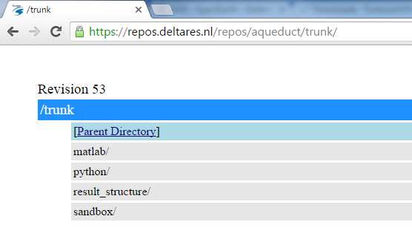
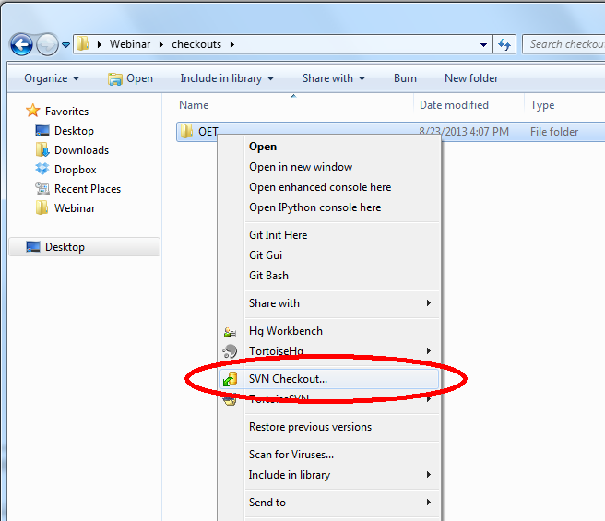
Step 1: checkout repository
Install TortoiseSVN from https://tortoisesvn.net/
Checkout repository https://repos.deltares.nl/repos/aqueduct/trunk/
(DO NOT USE THE "CREATE REPOSITORY HERE" OPTION" !, this is meant for creating a server-mother copy.)

Slide 4
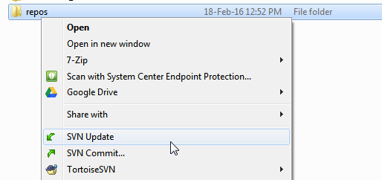
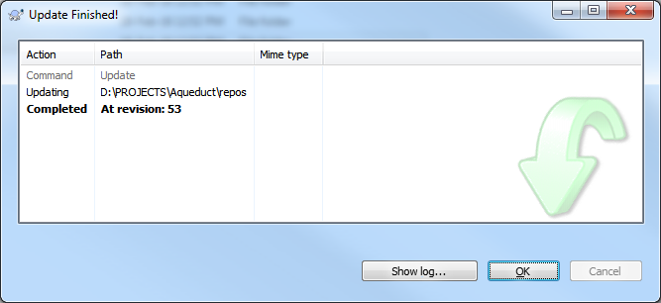
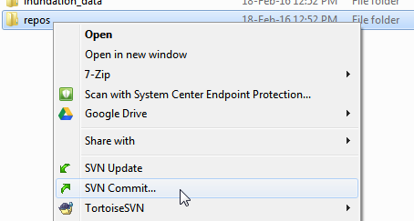
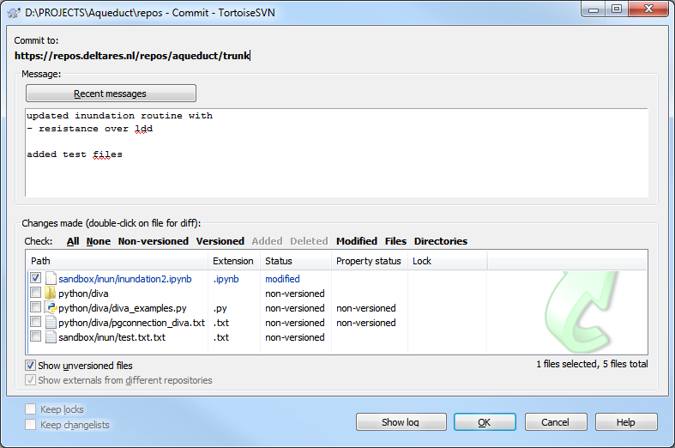
Step 2: Update & commit changes
When start editing files, first update your local files
After you’ve made changes or added a new file, commit your files to the repository

Slide 5
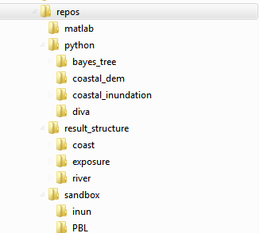
Current file structure

Slide 6
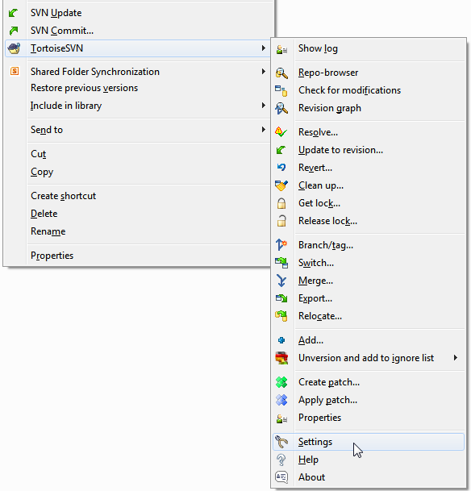
Subversion tips: Automatic keywords
Open settings from TortoiseSVN context menu

Slide 7
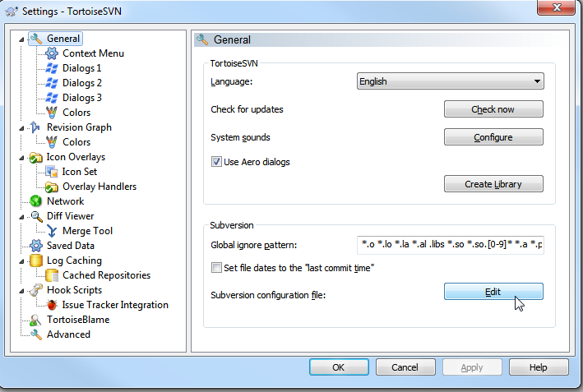
Subversion tips: Automatic keywords
Open settings from TortoiseSVN context menu
Open Subversion Config File

Slide 8
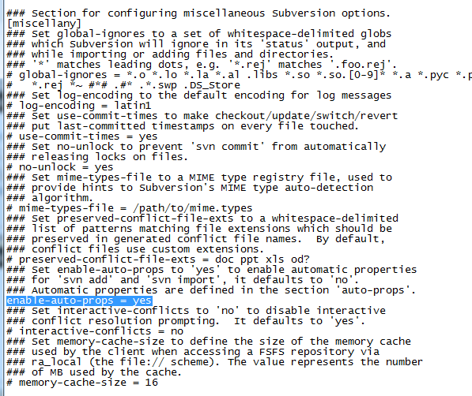
Subversion tips: Automatic keywords
Open settings from TortoiseSVN context menu
Open Subversion Config File
Uncomment
enable-auto-props = yes

Slide 9
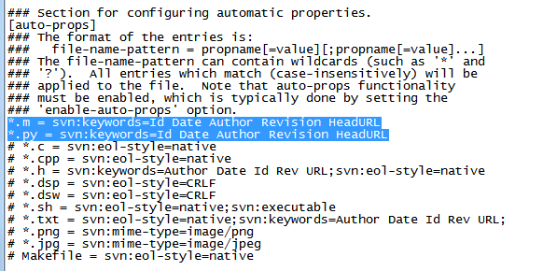
Subversion tips: Automatic keywords
Open settings from TortoiseSVN context menu
Open Subversion Config File
Uncomment
enable-auto-props = yes
Add following lines to config
*.m = svn:keywords=Id Date Author Revision HeadURL
*.py = svn:keywords=Id Date Author Revision HeadURL

Slide 10
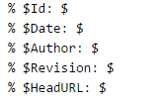
Subversion tips: Automatic keywords
Open settings from TortoiseSVN context menu
Open Subversion Config File
Uncomment
enable-auto-props = yes
Add following lines to config
*.m = svn:keywords=Id Date Author Revision HeadURL
*.py = svn:keywords=Id Date Author Revision HeadURL
When including the following lines your .m or .py files, the values will be automatically added while updating with subversion:

Slide 11
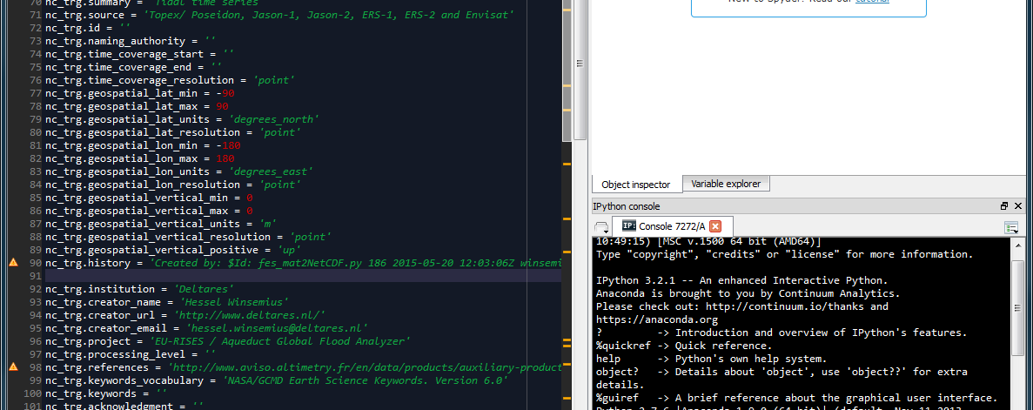
Making sure your keywords end up in metadata

Slide 12
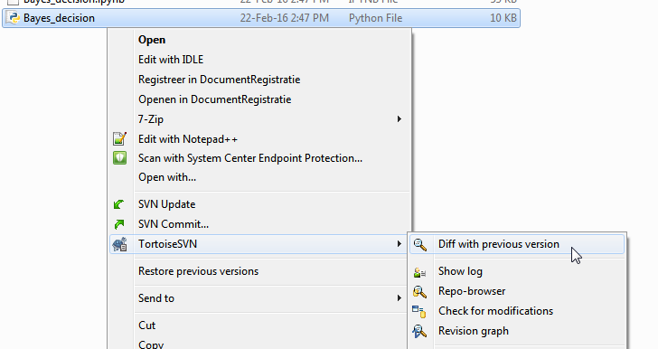
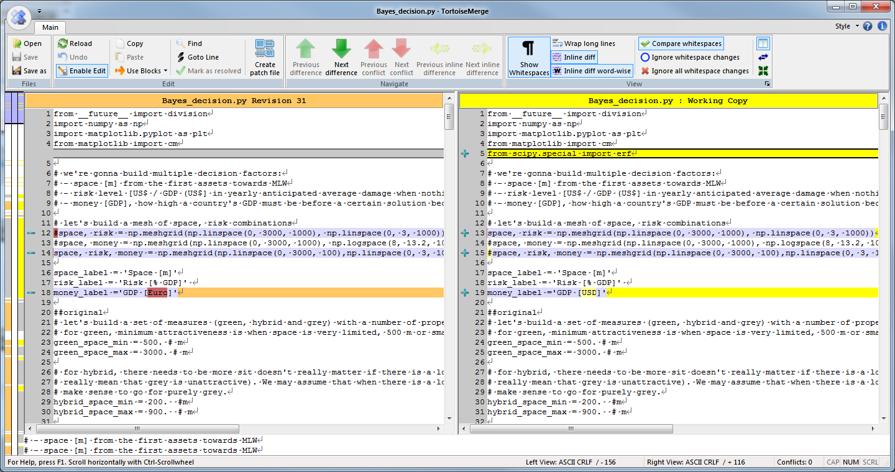
Subversion tips: compare reversions of files

